Slide 1

Exploring Coffee Quality
BHAVANA BALASA
S9322

Slide 2
Table of Contents
01
BUSINESS UNDERSTANDING
04
VISUALIZATION
02
DATA UNDERSTANDING
05
INSIGHTS
03
DATA PREPROCESSING

Slide 3
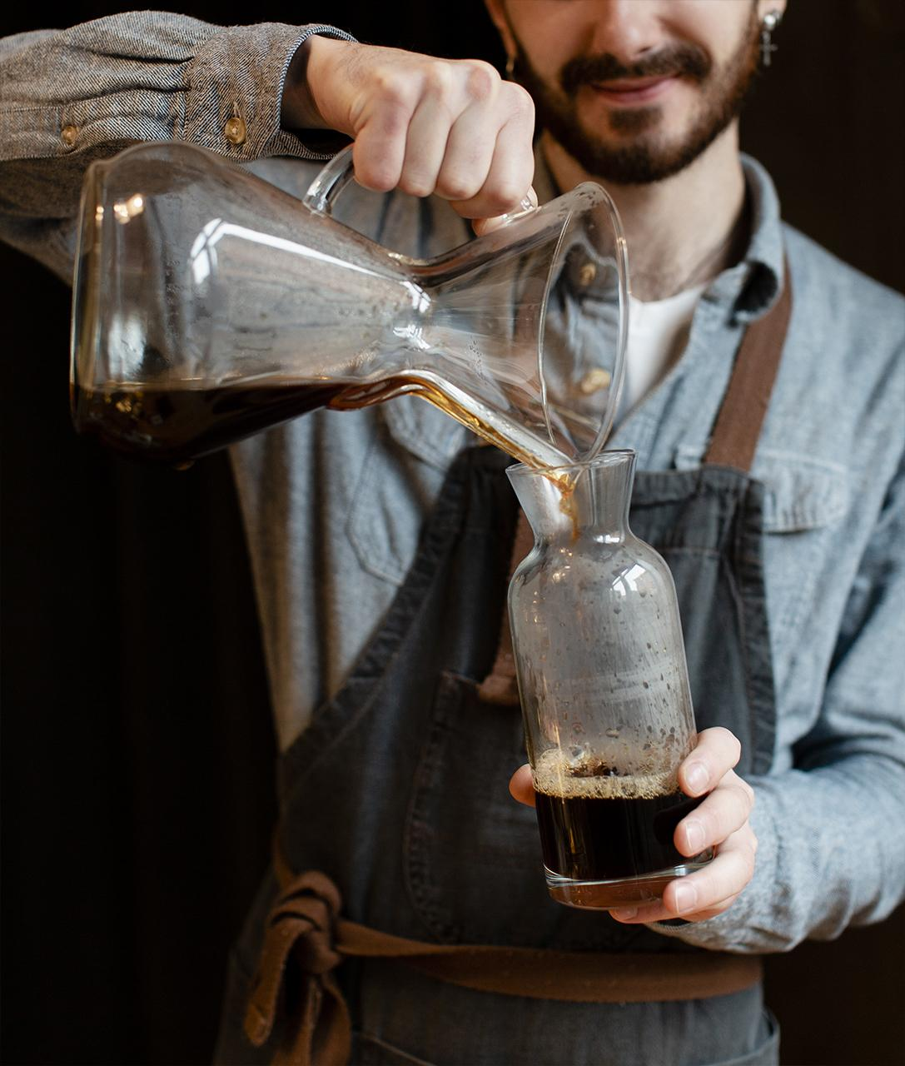
01
BUSINESS UNDERSTANDING

Slide 4
DESCRIPTION
The Coffee Quality Institute (CQI) is a non-profit organization that works to improve the quality and value of coffee worldwide.
CQI's mission is to promote coffee quality through research, training, and certification programs. The organization works with coffee growers, processors, roasters, and other stakeholders to improve coffee quality standards, promote sustainability, and support the development of the specialty coffee industry.

Slide 5
Data Understanding
02

Slide 6
Data Source Details:
The File used in this analysis is df_arabica_clean (2).csv. The data include Information on coffee production, processing, and sensory evaluation.
The data fields are ID, Country of Origin, Lot Number, Altitude, Region, Number of Bags, Bag Weight, In-Country Partner, Harvest Year, Grading, Date, Variety, Status, Processing Method, Aroma, Flavor, Aftertaste, Acidity, Body, Balance, Uniformity, Clean Cup, Sweetness, Overall Defects, Total Cup Points, Moisture, Percentage, Category One Defects, Quakers, Color, Category Two Defects, and Expiration.

Slide 7
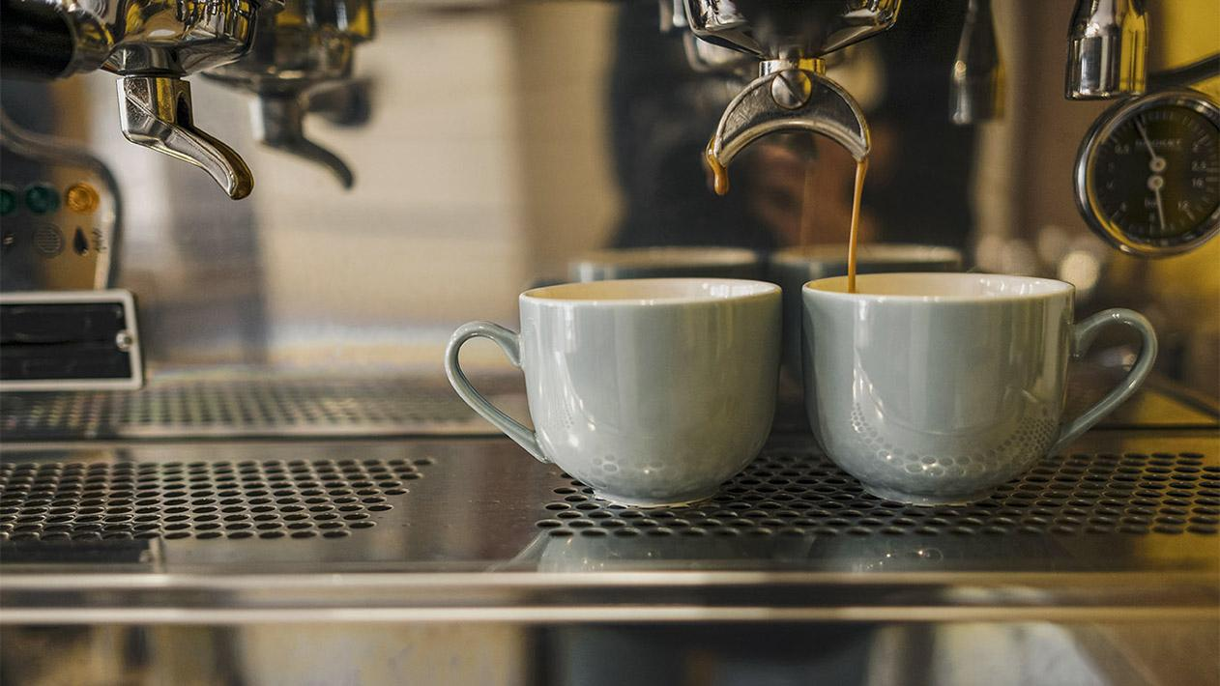
03
Data Preprocessing

Slide 8
In Power Query Editor:
Considering the feature engineering concept, analysis needs only a few attributes: ID, Country of Origin, Region, variety, Processing Method, Aroma, Flavour, Aftertaste, Acidity, Body, Balance, Uniformity, Sweetness, Clean cup, Overall, Total Cup Points, Category One Defects, Category Two Defects, and the remaining attributes are removed.
Checked data type of fields is appropriate and verified column quality and column distribution.
Row 105 is deleted as there are no values in region, variety, and Processing Method.
Removed the duplicates by combining the country, region, variety, and processing method selection.

Slide 9
In region replaced Chinese language words with English for consistency. It is capitalized as values are not appropriate. Some values are entered with full details replaced.
In variety field is capitalized and split into rows with delimiter comma, space,-,+. Replaced unknow, unknownn to unknown. Filtered blanks and unknown and last removed the duplicates.
Processing method Replaced blanks to null and filtered.
Remaining all the columns are clear with no errors.

Slide 10
Visualisation
04

Slide 11
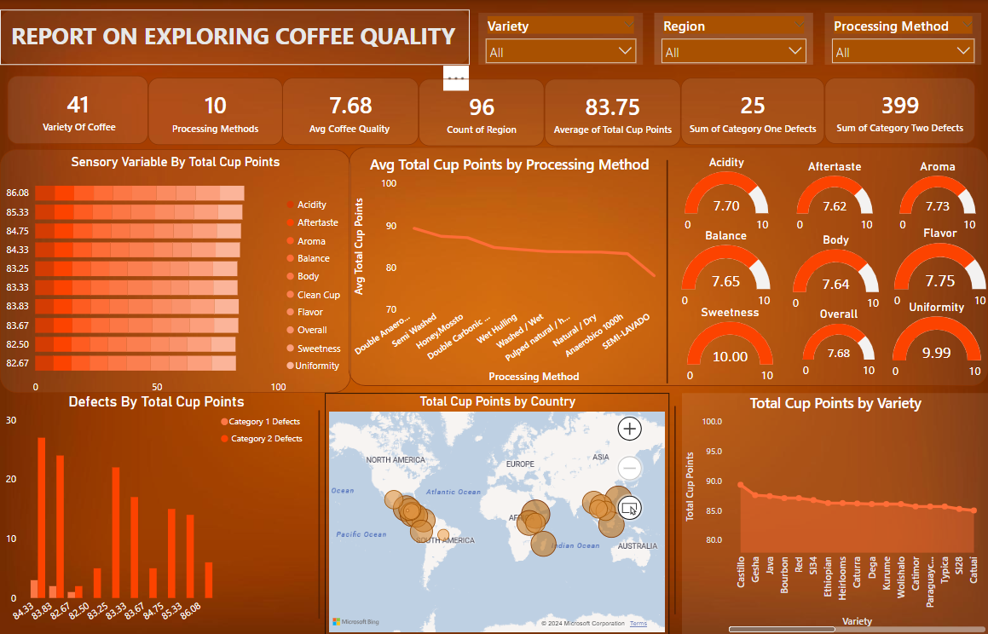

Slide 12

05
Insights

Slide 13
1. What are the key determinants of coffee quality as evaluated through sensory attributes such as aroma, flavor, acidity, etc.?
The key determinants of coffee quality are Aroma, Flavor, Aftertaste, Acidity, Body, and Balance. These Factors impact the coffee efficiency.

Slide 14
2. Is there a correlation between processing methods, origin regions, and coffee quality scores?
Based on the processing method quality of the coffee produced will vary.
Double Anaerobic Washed and Semi Washsed processes are the top methods to serve good coffee.
Piendamo, Tarrazu, and Loas borofen plateau are top regions in producing good quality coffee.

Slide 15
3. Can we identify any trends or patterns in defect occurrences and their impact on overall coffee quality?
Natural/Dry, Washed / Wet, and Pulped natural / honey methods produce more defects.
Category Two Defects are more the Category One Defects.

Slide 16
4. How do different variables interact to influence the Total Cup Points, which represent an overall measure of coffee quality?
1. The Overall Cup points of a Coffee is influenced by attributes Acidity, flavor, Aroma, Body, Balance, and After taste. The increase in these attributes enhances the Coffee Quality Points.
2. Double Anaerobic washed, Semi washed had high Total Cup Points.
3. Piendamo and Chiayi are the regions with high points.
4. Castillo, Gesha, and Java are top coffee varieties.

Slide 17

Thank You

Slide 18
Any Queries?

